Slide 1
Session 6

Slide 2
Content of session
01
02
Enemies
Load & save

Slide 3
01
Enemies

Slide 4
Types of Enemies

Slide 5
Types of Enemies
Stationary enemy
Patrolling enemy
Chasing enemy
Obstacle-Aware enemy
Boss enemy

Slide 6
Stationary enemy

Slide 7
Stationary enemy
What it does ?

Slide 8
Stationary enemy
stay in one place and shoot at the player when they enter its detection area or shoot forever.

Slide 9
Stationary enemy
Steps to make it

Slide 10
Stationary enemy
CharacterBody2D node for the turret
Add a Sprite2D for visuals and a CollisionShape2D for collision detection.
Add an Area2D node to detect the player.
Connect the body_entered signal to detect when the player enters the range.
Rotate the turret toward the player and spawn bullets. (or the turret rotation can be fixed)

Slide 11
Stationary enemy
Let’s code it

Slide 12
Patrolling enemy

Slide 13
Patrolling enemy
What it does ?

Slide 14
Patrolling enemy
Moves back and forth along a predefined path.
Chases the player when detected but returns to patrolling if the player escapes.

Slide 15
Patrolling enemy
Steps to make it

Slide 16
Patrolling enemy
Add a Path2D node and draw a path using the Curve2D editor.
Add a PathFollow2D node as a child of Path2D.
Use a script to move the enemy along the path.
Use an Area2D to detect the player and switch to chasing behavior.

Slide 17
Patrolling enemy
Let’s code it

Slide 18
Chasing enemy

Slide 19
Chasing enemy
What it does ?

Slide 20
Chasing enemy
Follows the player as soon as they are detected.
Does not stop until the player is out of range.

Slide 21
Chasing enemy
Steps to make it

Slide 22
Chasing enemy
Use an Area2D to detect the player.
Use basic movement logic to chase the player.

Slide 23
Obstacle-Aware enemy

Slide 24
Obstacle-Aware enemy
What it does ?

Slide 25
Obstacle-Aware enemy
Chases the player while avoiding obstacles.
Uses pathfinding to navigate around walls.

Slide 26
Obstacle-Aware enemy
Steps to make it

Slide 27
Obstacle-Aware enemy
Add a Navigation2D node and create a navigation mesh for the level.
Use NavigationAgent2D to handle pathfinding.

Slide 28
Boss enemy

Slide 29
Boss enemy
What it does ?

Slide 30
Boss enemy
Has multiple phases and attack patterns.
Combines behaviors like patrolling, chasing, and attacking.

Slide 31
Boss enemy
Steps to make it

Slide 32
Boss enemy
Use an enum to manage different states (e.g., idle, chasing, attacking).
Transition between phases when the boss’s health drops.

Slide 33
02
Save & load

Slide 34
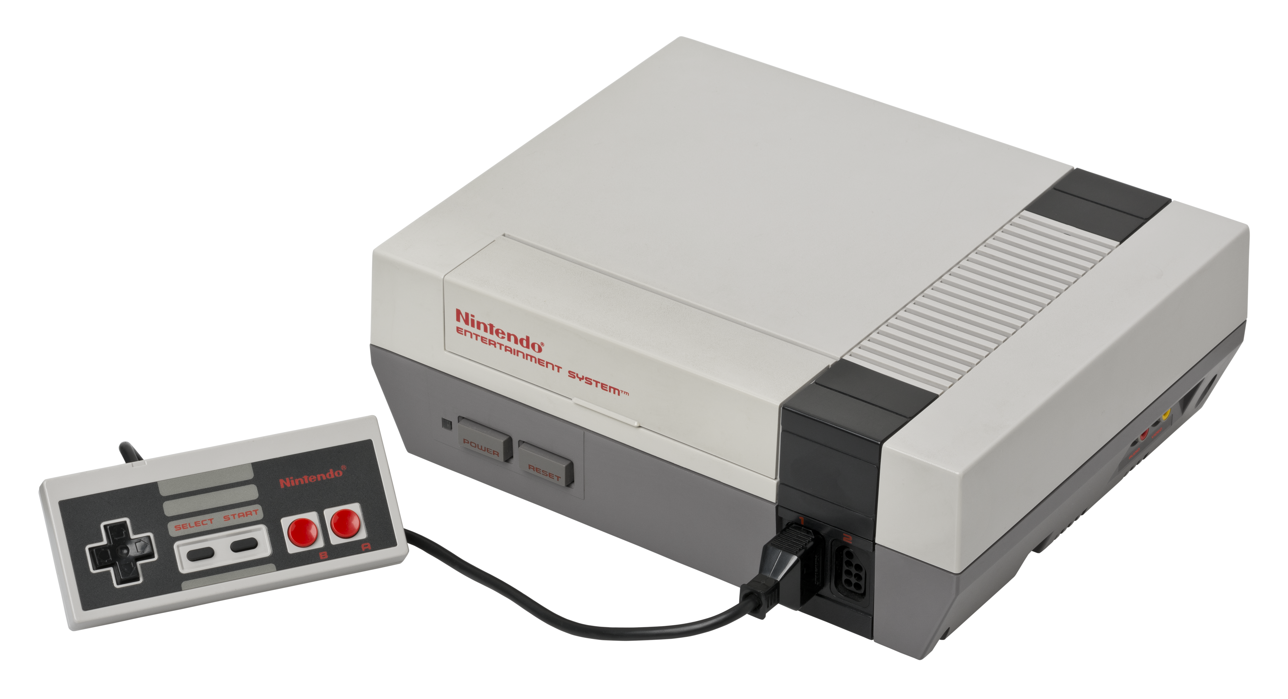
History of save
Consoles in the past did not have internal storage.
Which led developers to look for innovative solutions

Slide 35
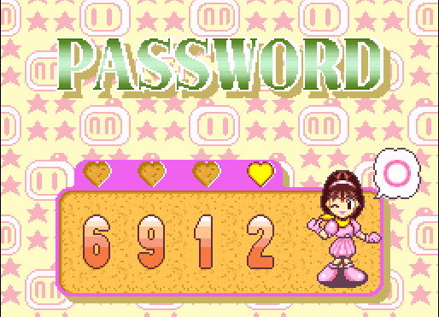
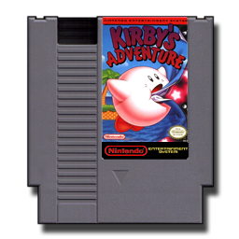
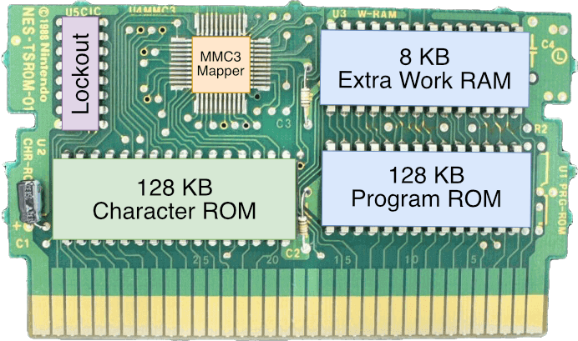
History of save
Such as entering a code that allows you to start from a specific level
Also put a small battery in the game cartridge to keep the memory running.
Notes:
After cd comes they should come with new idea so they make a separate memory cartridge to upload save file in it

Slide 36
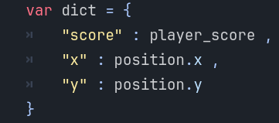
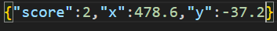
Save in Godot
Godot offers multiple methods for saving data. Today, we'll focus on saving with a JSON file
What’s Json?
JSON (JavaScript Object Notation) is a lightweight data format used for storing and exchanging structured data in Key-value format.
Notes:
After cd comes they should come with new idea so they make a separate memory cartridge to upload save file in it

Slide 37
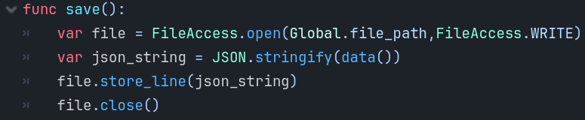
Save in Godot
First we need to prepare or data in dictionary format (Key-Value)
then we can create a file and save the data in it
Notes:
After cd comes they should come with new idea so they make a separate memory cartridge to upload save file in it

Slide 38
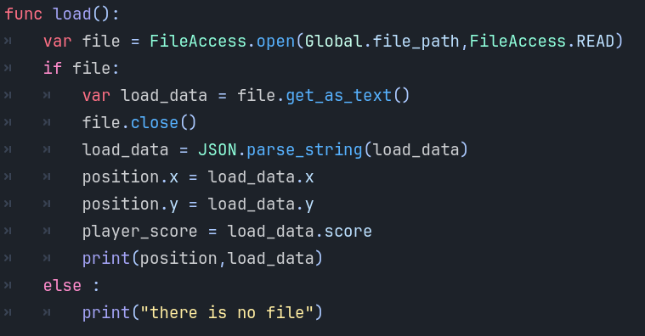
Save in Godot
Now we need to restore these data
Once we get the data back, we can use it normally
Notes:
After cd comes they should come with new idea so they make a separate memory cartridge to upload save file in it

Slide 39
Thanks!
Any Questions

